Slide 1
Sampling Frequency for Machine Learning to Separate Monitoring Artifact from Instability
Anthony Wertz, MS¹ ~ Marilyn Hravnak, RN, PhD, ACNP-BC, FAAN, FCCM²
Artur Dubrawski, PhD, MEng¹ ~ Lujie Chen, MS¹ ~ Tiffany Pellathy, MS, ACNP-BC²
Gilles Clermont, MD³ ~ Michael R. Pinsky, MD, MCCM³
1. Auton Lab, Robotics Institute, Carnegie Mellon University
2. School of Nursing, University of Pittsburgh
3. School of Medicine, University of Pittsburgh
Pittsburgh, PA, USA
Notes:
I would like to thank the Society of Critical Care Medicine for the opportunity to present our work here today, and I would like to thank my coauthors as well.

Slide 2
Disclosures
Funding: NIH R01NR013912
No commercial conflict of interest
Notes:
We acknowledge our grants funding from the NIH and have no commercial conflicts of interest.

Slide 3
Motivation
We know: Vital sign (VS) data collected every 20s can be used to adjudicate alerts, classifying them as either artifacts or real instabilities.
We asked: Would sampling VS data less frequently impair ability to define real vs. artifact alerts?
Hypothesis:
Models using data sampled less frequently can be used to adjudicate alerts.
Why evaluate lower sampling frequencies?
20s resolution is often not available in deployed systems.
How far can we downsample without losing clinical utility?
Higher data frequencies entail higher collection and storage costs.
In retrospective analysis existing data repositories may have only low frequency data.
Notes:
Previously we’ve shown that vital sign data can be used to adjudicate alerts, classifying them as either artifacts or real instabilities, but that data was sampled every 20 seconds. We wanted to know what affect less frequent sampling would have on our models. What our work shows is that we can reduce the sampling frequency of vital sign data without significantly impacting performance.

Slide 4
Motivation
We know: Vital sign (VS) data collected every 20s can be used to adjudicate alerts, classifying them as either artifacts or real instabilities.
We asked: Would sampling VS data less frequently impair ability to define real vs. artifact alerts?
Hypothesis:
Models using data sampled less frequently can be used to adjudicate alerts.
Why evaluate lower sampling frequencies?
20s resolution is often not available in deployed systems.
How far can we downsample without losing clinical utility?
Higher data frequencies entail higher collection and storage costs.
In retrospective analysis existing data repositories may have only low frequency data.
Notes:
But why is this important? To start, 20 second vital sign data isn’t available in all deployed systems, so how much can we downsample without losing clinical utility? Also, higher frequency data entails higher collection and storage costs, and in retrospective analyses we may only have lower frequency data to work with.

Slide 5
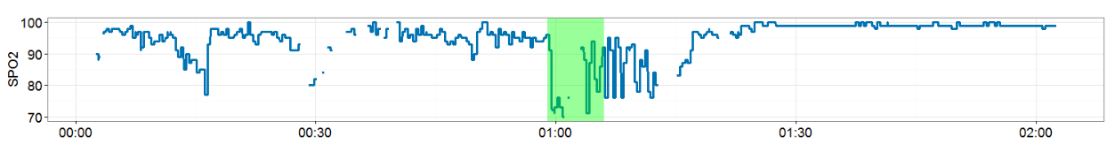
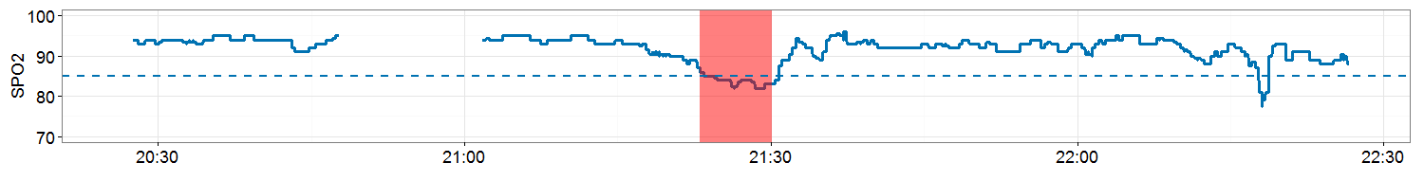
Importance of Artifact Detection
For Clinicians:
Treat artifact vs instability differently.
Delayed response time due to alarm fatigue.
For Modelling Instability:
More difficult in the presence of artifacts.
Might end up modeling the artifact instead
Bonafide et al. J Hosp Med. 2015; 10(6):345-51
Alerts versus Artifacts
Artifact
Data sparseness
Drop off
Oscillation
Real
Notes:
But this task is important, both to clinicians and to data analysts.
For clinicians, how you need to respond to an alert will be very different from how you respond to a real instability, so knowing which it is will help inform your actions at the bedside. It may also help address alarm fatigue by helping inform you which alerts need to be addressed immediately.
Artifact detection is important to data analysts as well. Presence of many artifacts makes data modeling difficult by skewing the data distributions and introducing non-physiological behaviors. And, if artifacts frequently occur near the event of interest, you may end up modeling the artifact instead of the event.
Okay, so can we do this with lower frequency data?

Slide 6
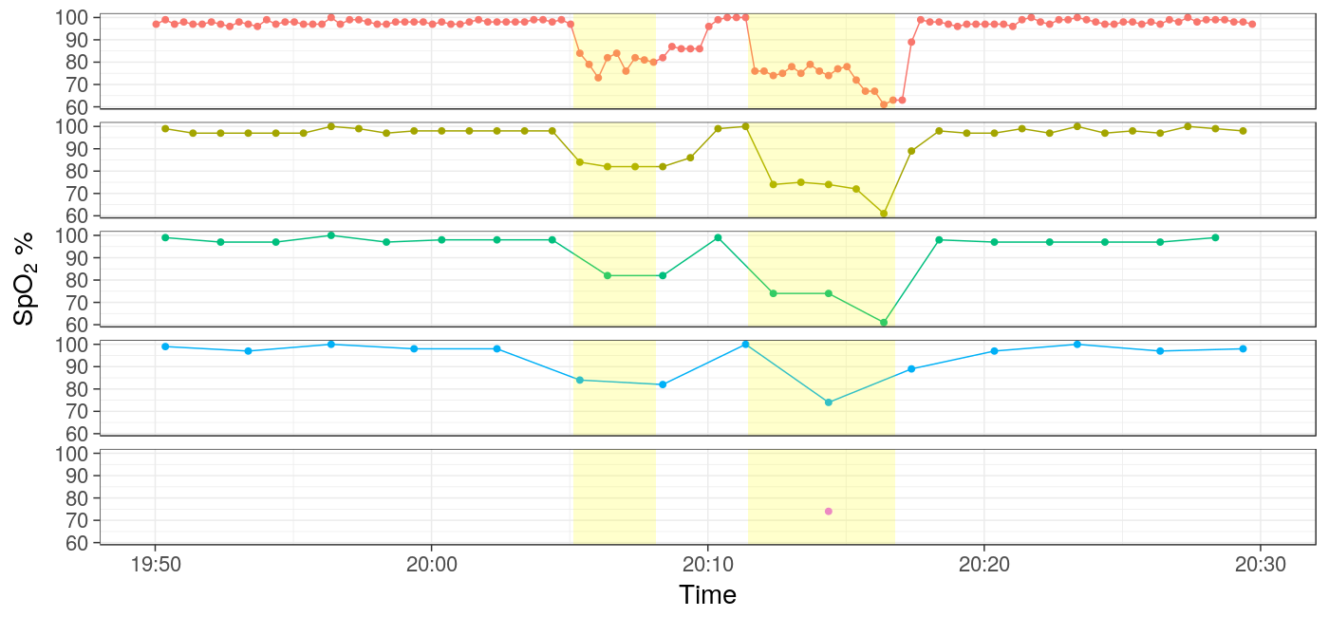
Original Vital Sign Data Collected Every 20s
SpO₂ signal at various levels of downsampling
Every 20 seconds
Every 60 seconds
Every 120 seconds
Every 180 seconds
Every 60 minutes
Notes:
Here’s a sample of the original vital sign data, collected once every 20 seconds. To simulate data capture at lower frequencies we downsample the data. By this I mean we remove some data points so successive observations occur farther apart in time.

Slide 7
Downsampling Reduces Number of Observations
SpO₂ signal at various levels of downsampling
Every 20 seconds
Every 60 seconds
Every 120 seconds
Every 180 seconds
Every 60 minutes
Notes:
Here’s the signal sampled once every 60 seconds. You see we’ve removed two thirds of the data.

Slide 8
Downsampling Reduces Number of Observations
SpO₂ signal at various levels of downsampling
Every 20 seconds
Every 60 seconds
Every 120 seconds
Every 180 seconds
Every 60 minutes
Notes:
Downsampling again removes more data…

Slide 9
Downsampling Reduces Number of Observations
SpO₂ signal at various levels of downsampling
Every 20 seconds
Every 60 seconds
Every 120 seconds
Every 180 seconds
Every 60 minutes
Notes:
…and again even more data…

Slide 10
Excessive Downsampling May Leave Too Little Data
SpO₂ signal at various levels of downsampling
Every 20 seconds
Every 60 seconds
Every 120 seconds
Every 180 seconds
Every 60 minutes
Notes:
…until eventually we’re left with very little data to work with. We’ll look at classification performance for all of these scenarios…

Slide 11
Dataset Collected from Step Down Unit Patients
Collected continuous vital sign (VS) data streams from 200 step-down unit (SDU) patients.
Heart rate (HR) - 3-lead ECG.
Respiratory rate (RR) - bioimpedance signaling.
Pulse O₂ saturation (SpO₂) - pulse oximeter.
Intermittent noninvasive blood pressure (BP) - sphygmomanometer.
Cardiorespiratory instability (CRI) alerts generated when VS signals are outside defined thresholds.
Alerts labeled “real” or “artifact” by clinical investigators as previously reported.
Hravnak et al. J Clin Monit Comp 2016; 30:875-88
Notes:
…but first, a bit about the dataset. Previously, we collected continuous vital sign data from 200 step down unit patients. Using this, we generate cardiorespiratory alerts when the vital signs stray outside of our established thresholds. These alerts are manually labeled as either artifacts or real instabilities.

Slide 12
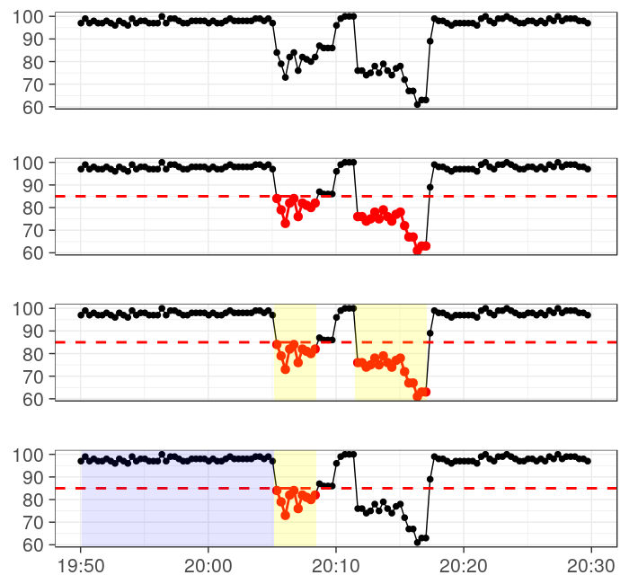
Alerts Generated as Vital Signs Move Outside Thresholds
Alerts generated using established process. *
Mark detection “out of bounds” if it is outside specified thresholds.
Alert thresholds: [**]
Alert if out of bounds for at least 3 minutes.
SpO₂ %
HR < 40 | OR | HR > 140
RR < 9 | OR | RR > 36
SpO₂ < 85
Sys < 80 | OR | Sys > 200
Dia > 110
* Hravnak et al. J Clin Monit Comp 2016; 30:875-88
Notes:
As I mentioned, these alerts are generated following the process we established in our previous work.

Slide 13
Alerts Generated as Vital Signs Move Outside Thresholds
Alerts generated using established process. *
Mark observation “out of bounds” if it is outside specified thresholds.
Alert thresholds: [**]
Alert if out of bounds for at least 3 minutes.
SpO₂ %
HR < 40 | OR | HR > 140
RR < 9 | OR | RR > 36
SpO₂ < 85
Sys < 80 | OR | Sys > 200
Dia > 110
* Hravnak et al. J Clin Monit Comp 2016; 30:875-88
Notes:
First, we mark observations outside of their established thresholds as “out of bounds”.

Slide 14
Alerts Generated as Vital Signs Move Outside Thresholds
Alerts generated using established process. *
Mark observation “out of bounds” if it is outside specified thresholds.
Alert thresholds: **
Alert if out of bounds for at least 3 minutes.
SpO₂ %
HR RR SpO₂ Sys Dia | < < < < > | 40 9 85 80 110 | OR OR OR | HR RR Sys | > > > | 140 36 200
* Hravnak et al. J Clin Monit Comp 2016; 30:875-88
** Chen et al. Critical care medicine 2016; 44(7):e456-e463
Notes:
These are the thresholds we used.

Slide 15
Alerts Generated as Vital Signs Move Outside Thresholds
Alerts generated using established process. *
Mark observation “out of bounds” if it is outside specified thresholds.
Alert thresholds: **
Alert if out of bounds for at least 3 minutes.
HR RR SpO₂ Sys Dia | < < < < > | 40 9 85 80 110 | OR OR OR | HR RR Sys | > > > | 140 36 200
SpO₂ %
* Hravnak et al. J Clin Monit Comp 2016; 30:875-88
** Chen et al. Critical care medicine 2016; 44(7):e456-e463
Notes:
An alert is generated if the observations are out of bounds for at least three minutes.

Slide 16
Features Generated from Downsampled Vital Sign Data
VS data downsampled to one observation every 20 seconds (original), 60s, 120s, 180s, and 60 minutes.
Features generated using data in alert window (featurization).
Feature: Secondary variable generated from original signal.
15 minutes prior to the alert used as a baseline.
Raw VS along with generated features are the inputs to the models.
SpO₂ %
Notes:
So those are the alerts we’re trying to adjudicate. To train models for this task we first downsample the vital sign data to one sample every 60 seconds, 120 seconds, 180 seconds, or 60 minutes. From that downsampled data we generate secondary variables, which we call features, using the data in each alert window. The preceding 15 minutes is used as a baseline.

Slide 17
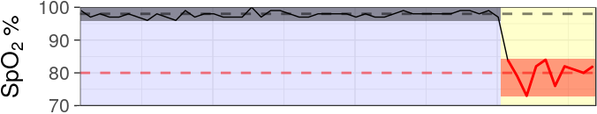
Featurizing Time Series by Evaluating Data Near Event
Data in the alert window used to compute statistics (e.g. mean, standard deviation, etc), trends, and other metrics.
These features used as inputs to classification models.
Models trained to label alerts as real or artifact.
Ranges
Means
Notes:
We generate a variety of features, here I’ve shown two simple examples: you see the data ranges and means in the alert window and the baseline window. All of these features are used as the inputs to the models we train to distinguish artifacts from real alerts.

Slide 18
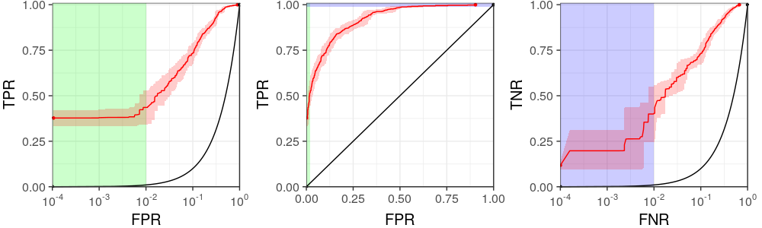
Models Evaluated through Cross Validation and ROCs
Models evaluated in a leave-one-patient-out cross validation framework.
Random forest models trained (Auton Lab variant).
Handles missing values.
Builds explainable models.
Supports non-linear decision boundaries.
Successfully used in many other similar projects.
Performance compared using receiver operator characteristic (ROC) curves.
Notes:
The models are evaluated in a leave one patient out cross validation framework. That means we remove one patient, train a model on all the remaining patients, then evaluate the model on the patient who was removed. We do this for each patient.

Slide 19
Models Evaluated through Cross Validation and ROCs
Models evaluated in a leave-one-patient-out cross validation framework.
Random forest models trained (Auton Lab variant).
Handles missing values.
Builds explainable models.
Supports non-linear decision boundaries.
Successfully used in many other similar projects.
Performance compared using receiver operator characteristic (ROC) curves.
Notes:
We train random forest classifiers for this task. While there are many reasons to choose this model, importantly we’ve already shown good results using them on the same task with the 20 second data.

Slide 20
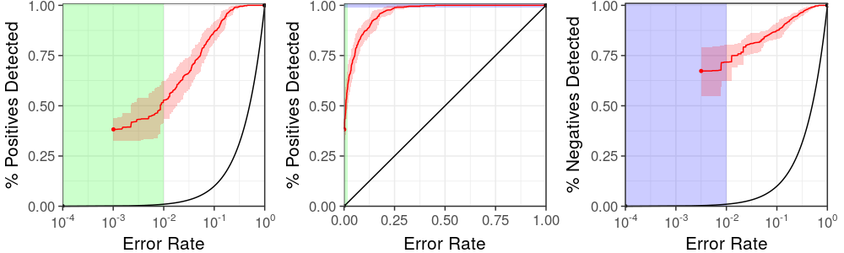
Models Evaluated through Cross Validation and ROCs
Models evaluated in a leave-one-patient-out cross validation framework.
Random forest models trained (Auton Lab variant).
Handles missing values.
Builds explainable models.
Supports non-linear decision boundaries.
Successfully used in many other similar projects.
Performance compared using receiver operator characteristic (ROC) curves.
Positive class: Artifact
Negative class: Real instability
Notes:
I’ll be presenting all of our results using receiver operating characteristic curves, or ROCs, so it is very important for you to understand how to read them.
The figure you see here shows two curves: the black line is the performance you would get if your model simply chooses a class at random. Generally speaking, moving the curve toward the top left corner indicates a better performing model.
The ROC illustrates the tradeoff you make when setting a detection threshold between your model’s ability to make correct detections and the rate at which it makes an error. Operationally we’re only interested in very low error rates. I’ve shaded the error rate of 1 in 100 or less green on the left and blue on top in the figure, but you can barely see those regions of the plot, so what you can do is…

Slide 21
Models Evaluated through Cross Validation and ROCs
Models evaluated in a leave-one-patient-out cross validation framework.
Random forest models trained (Auton Lab variant).
Handles missing values.
Builds explainable models.
Supports non-linear decision boundaries.
Successfully used in many other similar projects.
Performance compared using receiver operator characteristic (ROC) curves.
Positive class: Artifact
Negative class: Real instability
Notes:
…put the error rate on the log scale to zoom in on those lower values. Now you can see them clearly.

Slide 22
Models Evaluated through Cross Validation and ROCs
Models evaluated in a leave-one-patient-out cross validation framework.
Random forest models trained (Auton Lab variant).
Handles missing values.
Builds explainable models.
Supports non-linear decision boundaries.
Successfully used in many other similar projects.
Performance compared using receiver operator characteristic (ROC) curves.
Positive class: Artifact
Negative class: Real instability
Notes:
We can do this on the other side of the curve as well, again zooming into the low error rates we’re interested in.

Slide 23
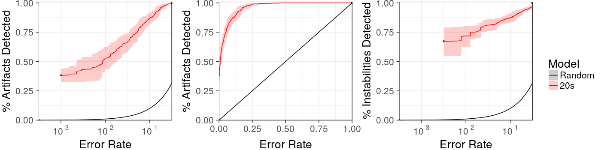
Performance of Original 20s Model
Positive class: Artifact
Negative class: Real instability
Notes:
Now lets get into the results. Here you can see the performance of the original model using 20 second vital sign data.

Slide 24

Detect 40% of Artifacts
Positive class: Artifact
Negative class: Real instability
Using this threshold we correctly detect 40% of artifacts with only 1 error in 1000 decisions.
Notes:
As you can see on the left, we can choose a threshold such that we’re able to correctly classify 40% of artifacts, making a mistake only once every 1000 decisions.

Slide 25
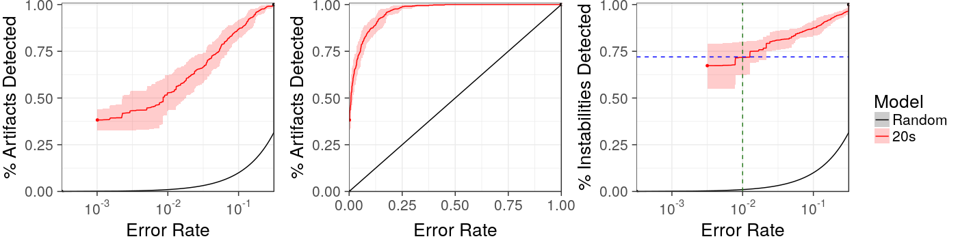
Detect 72% of Real Instabilities
Positive class: Artifact
Negative class: Real instability
Using this threshold we correctly detect 72% of artifacts with only 1 error in 100 decisions.
Notes:
Likewise, as you can see on the right, we can choose another threshold such that we correctly identify 72% of real instabilities while making a mistake only once every 100 decisions.

Slide 26
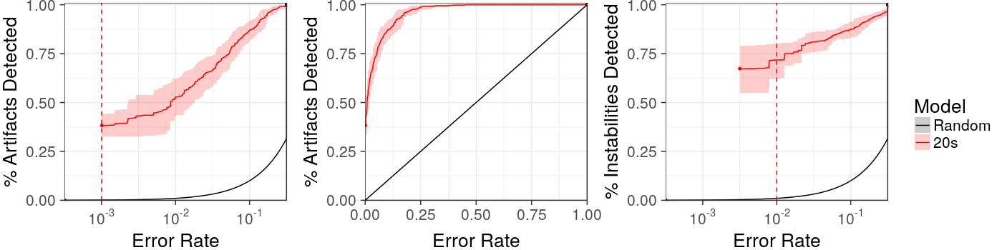
For Uncertain Predictions Fall Back To Standard Practice
Positive class: Artifact
Negative class: Real instability
For predictions in between the model is less certain. Fall back on current standard practice.
Notes:
For all other thresholds our model is less certain, so we can just fall back on the current standard practice.

Slide 27
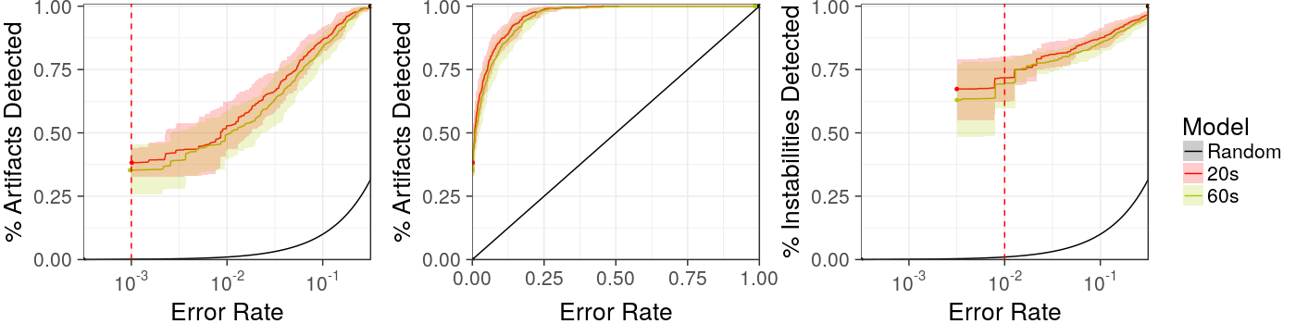
Nearly Identical Performance Sampling Every 60s
Positive class: Artifact
Negative class: Real instability
Notes:
Now we can compare performance after downsampling to one observation every 60 seconds. As you can see there is no significant performance degradation despite sampling less frequently. The 60 second model maintains the performance of the original 20 second model.

Slide 28
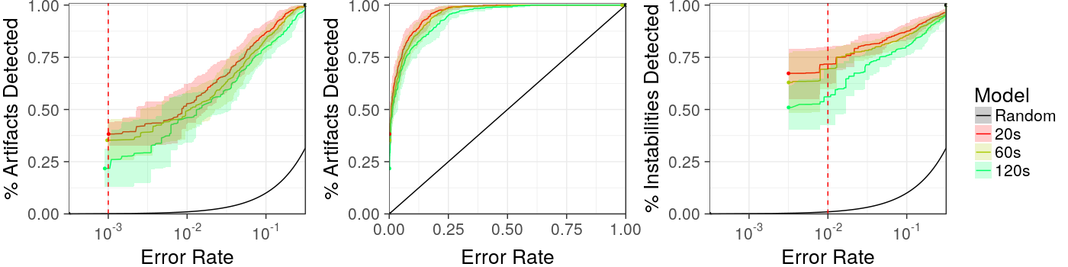
120s Model Still Differs Insignificantly
Positive class: Artifact
Negative class: Real instability
Notes:
Downsampling further to every 120 seconds starts to show some degradation, but it is not significantly different than the original model.

Slide 29
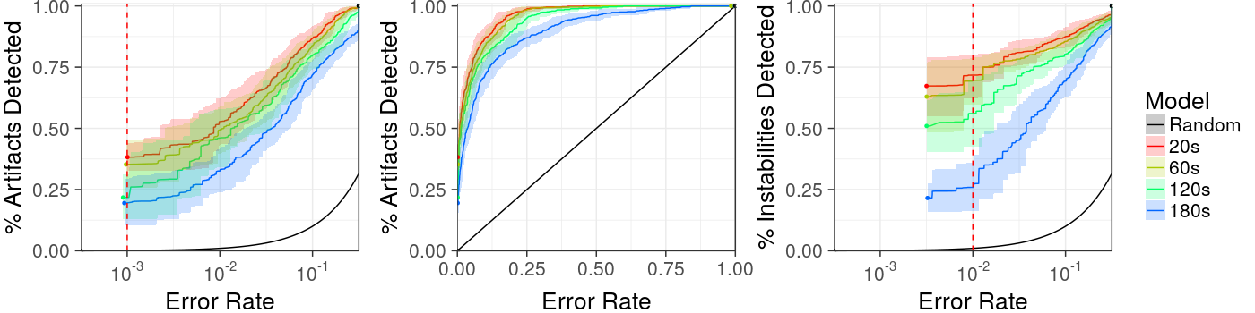
180s Model Degrades Significantly
Positive class: Artifact
Negative class: Real instability
Notes:
As you can see the 180 second model is the first to show some significant degradation, especially on the right plot, indicating it is less capable to correctly identify real instabilities.

Slide 30
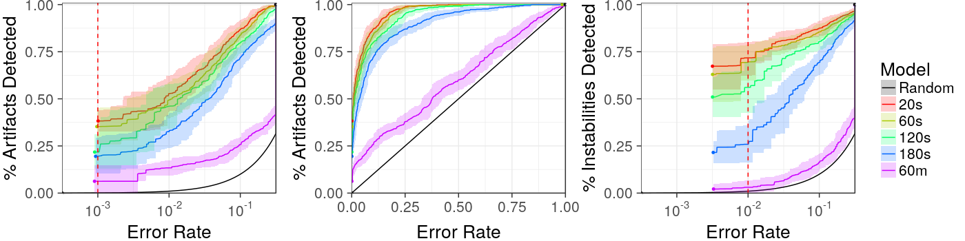
Sampling Every 60m is Detrimental to Performance
Positive class: Artifact
Negative class: Real instability
Notes:
And at one sample every 60 minutes the model does not perform well at all, we’ve removed too much data.

Slide 31
Good Model Performance if Sampling Every 1 or 2 Minutes
Positive class: Artifact
Negative class: Real instability
Key Finding: Data sampled every one or two minutes can be used to adjudicate alerts.
Notes:
But what is really interesting, as you see here: we’re able to maintain our performance when sampling at least every one or two minutes.

Slide 32
Lower Frequency Data Can Be Used to Classify Alerts
Key Finding
Vital sign data collected as infrequently as every 120 seconds can be used to adjudicate alerts without significantly sacrificing model performance.
Impact (Why we care)
Analysis applicable to a wider range of existing systems which sample at lower rates.
Helps understand trade offs between sampling frequency and clinical utility of the models.
Next Steps
Does sampling more frequently improve performance? Work on similar projects suggests we can derive more descriptive features when higher frequency data is available.
Notes:
This is the key point: vital sign data collected as infrequently as every 120 seconds can be used to adjudicate alerts.

Slide 33
Lower Frequency Data Can Be Used to Classify Alerts
Key Finding
Vital sign data collected as infrequently as every 120 seconds can be used to adjudicate alerts without significantly sacrificing model performance.
Impact (Why we care)
Analysis applicable to a wider range of existing systems which sample at lower rates.
Helps understand trade offs between sampling frequency and clinical utility of the models.
Next Steps
Does sampling more frequently improve performance? Work on similar projects suggests we can derive more descriptive features when higher frequency data is available.
Notes:
Why do we care? This shows the model can perform well in a wider range of existing systems and is not limited only to those able to collect every 20 seconds. Further, it helps us understand the tradeoffs between sampling frequency and clinical utility.

Slide 34
Lower Frequency Data Can Be Used to Classify Alerts
Key Finding
Vital sign data collected as infrequently as every 120 seconds can be used to adjudicate alerts without significantly sacrificing model performance.
Impact (Why we care)
Analysis applicable to a wider range of existing systems which sample at lower rates.
Helps understand trade offs between sampling frequency and clinical utility of the models.
Next Steps
Does sampling more frequently improve performance? Work on similar projects suggests we can derive more descriptive features when higher frequency data is available.
Notes:
Moving forward we would like to investigate whether increasing the sampling frequency can significantly improve performance. Work we’ve done on similar projects suggests we can derive more informative metrics from higher density data, so we’re excited by the prospect.
Thank you.

